Slide 1
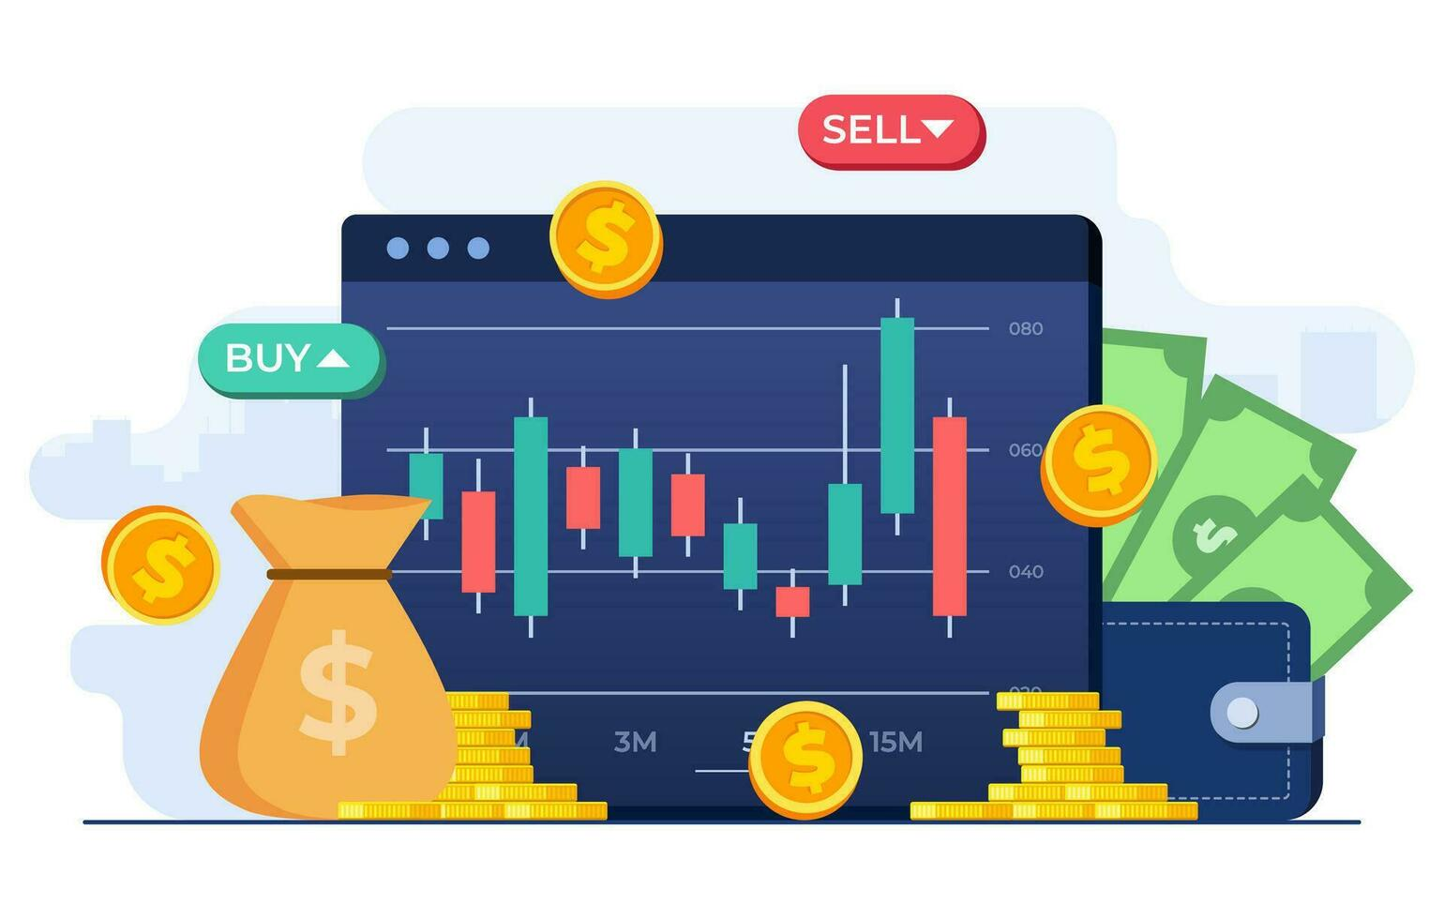
TOPIC NAME:
STOCK PRICE PREDICTION AND ANALYSIS
Presented By: Soumili Ghosh

Slide 2
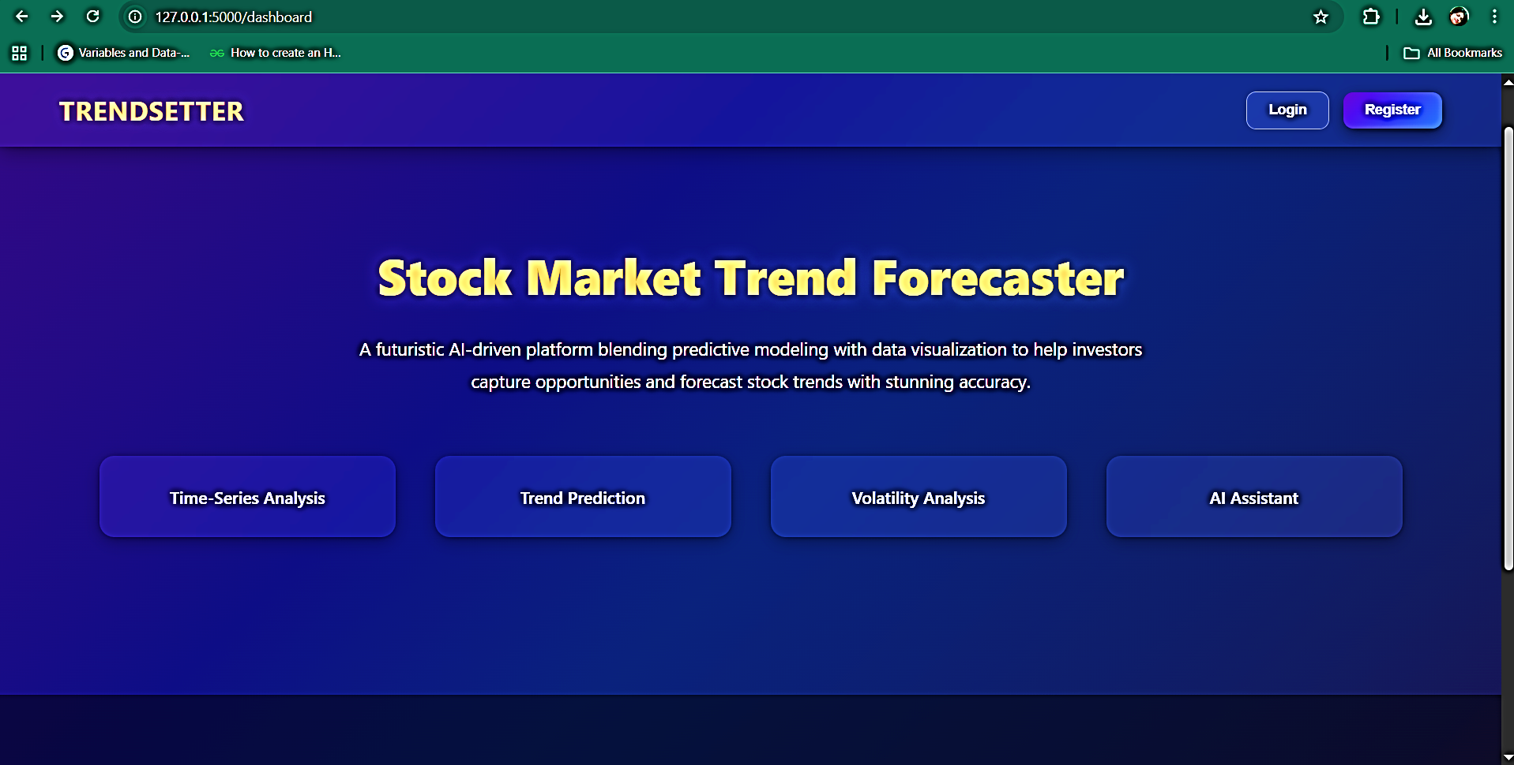
INTRODUCTION
The stock market is dynamic, with prices changing every second.
Investors need intelligent tools to analyze past data, predict trends, and manage risks.
Traditional methods often fail to capture complex stock patterns.
Our project delivers a Stock Analysis Dashboard with 4 key features.
The system offers a user-friendly interface to support smarter, data-driven investment decisions.
FUNCTIONALITIES OVERVIEW
Stock Analysis for Company
Stock Price Prediction Dashboard
Stock Volatility Analysis
AI Stock Assistant

Slide 3
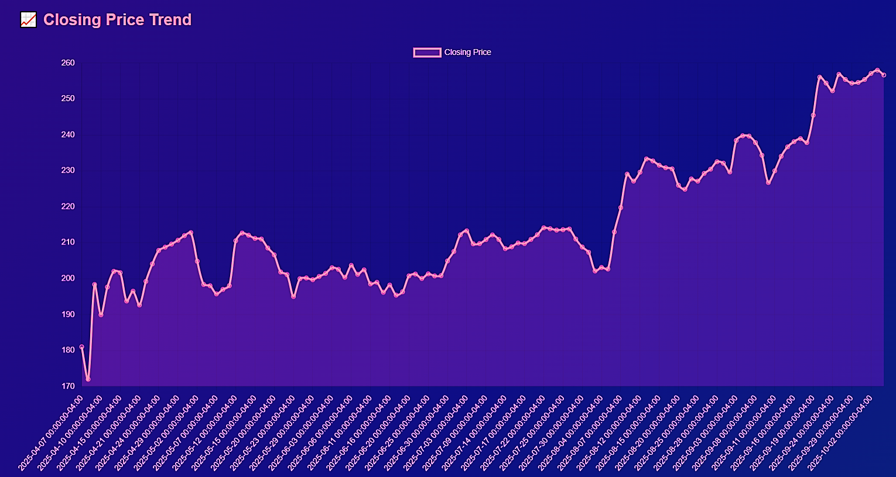
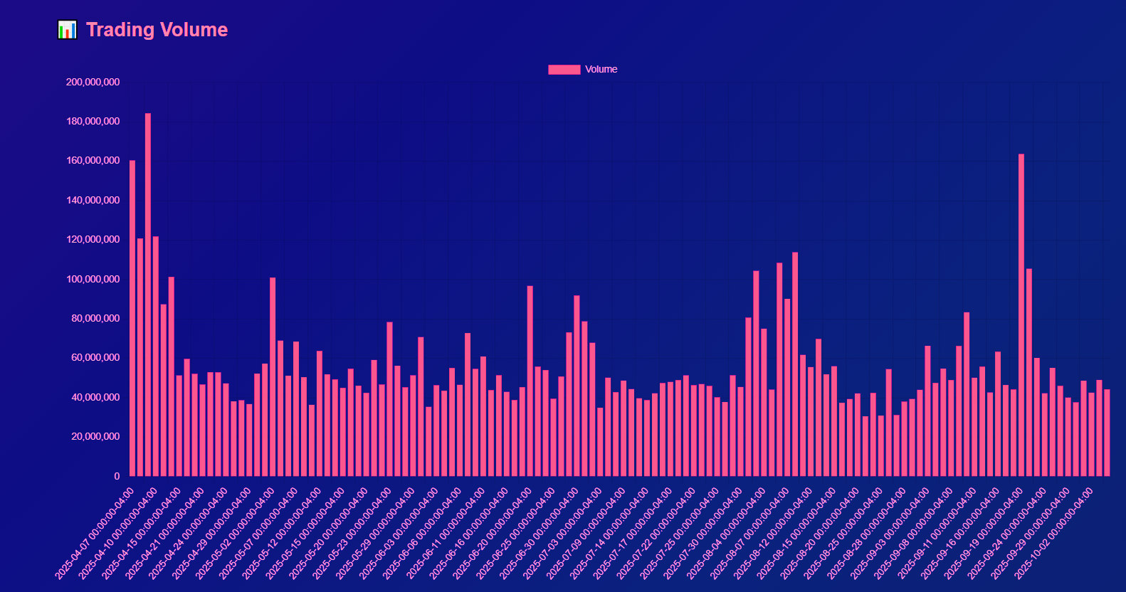
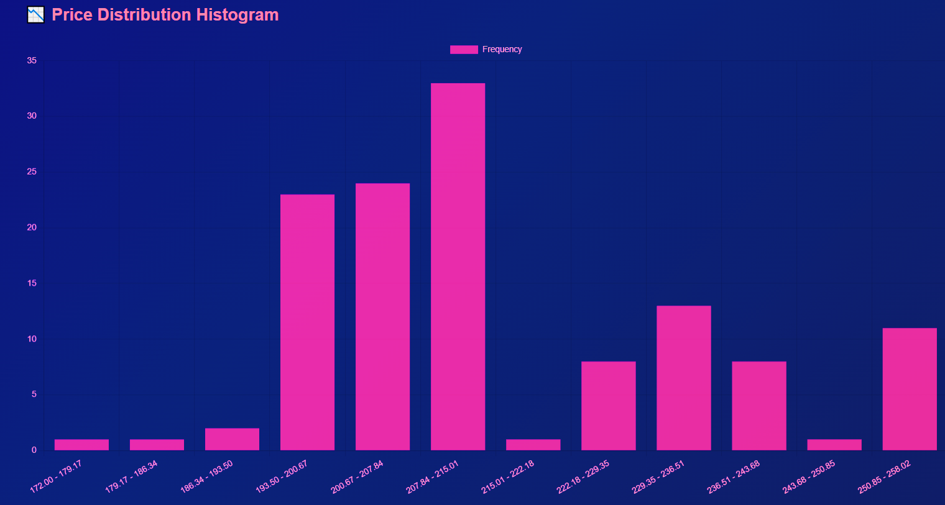
FUNCTION 1: STOCK ANALYSIS FOR COMPANY
Allows users to select a company for detailed analysis.
Provides closing price trend visualization to understand price movement.
Shows trading volume trend for investor activity insights.
Displays price distribution histogram for identifying common trading ranges.
Includes average price visualization for long-term perspective.
This functionality helps in understanding the company’s overall stock performance and investor behaviour.

Slide 4
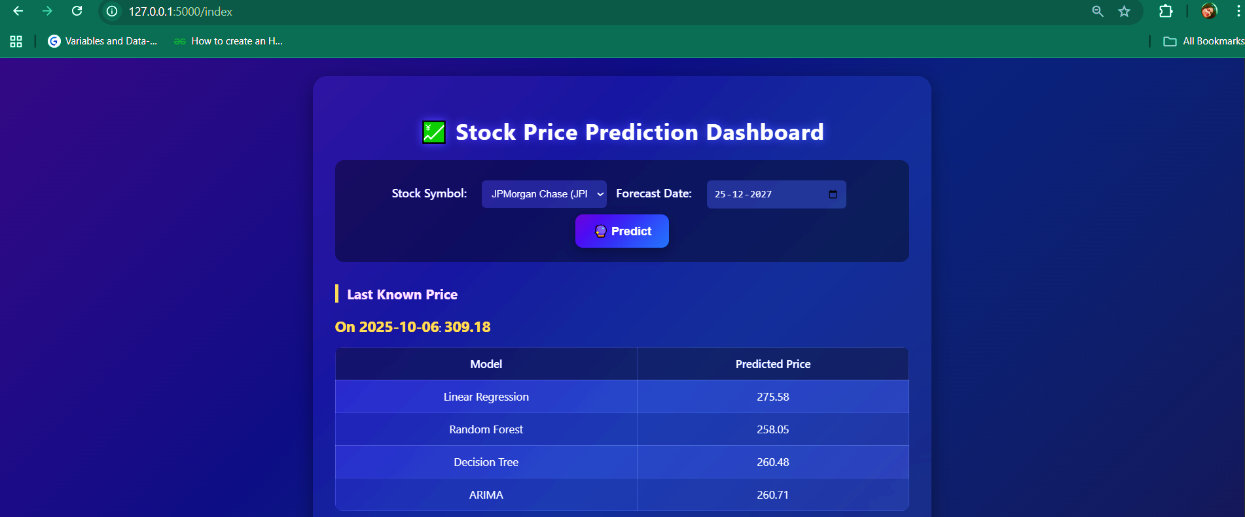
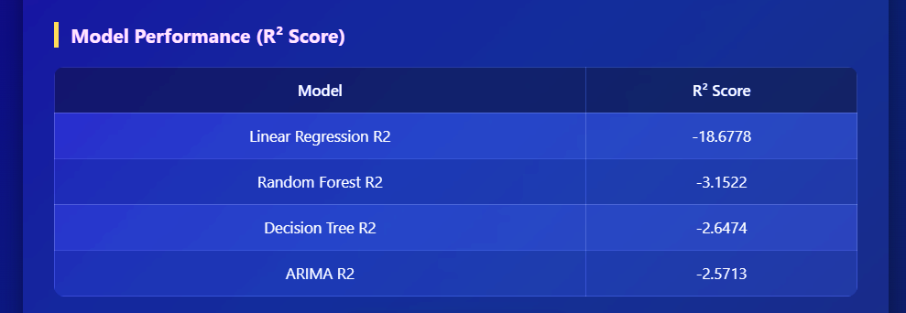
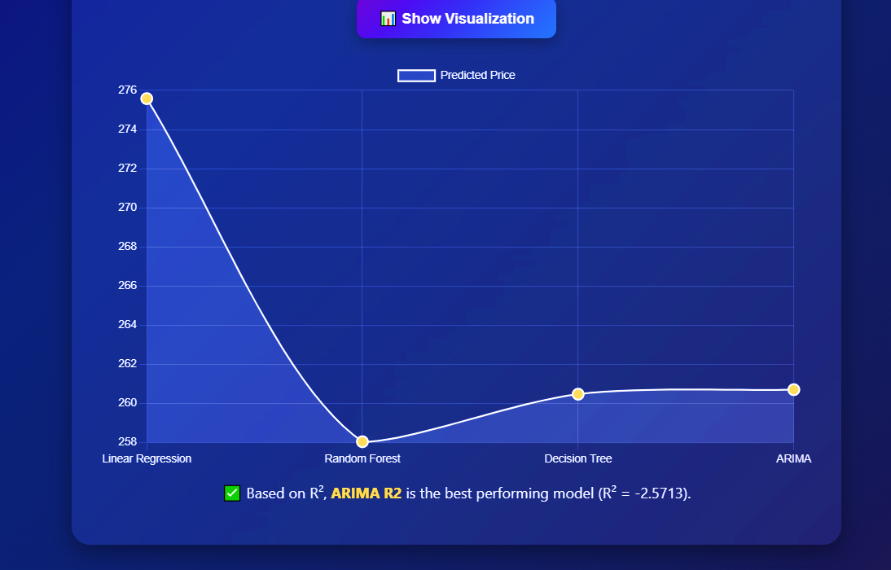
FUNCTION 2: STOCK PRICE PREDICTION DASHBOARD
Enables forecasting of future stock prices using multiple machine learning models.
Example: Stock Symbol - META (Meta Platforms Inc.), Forecast Date: 25-12-2027.
Models Used:
- Linear Regression, Random Forest, Decision Tree, ARIMA.
Provides predicted prices along with last known price for comparison.
Displays model performance metrics (R² Score) to evaluate accuracy.
Interactive dashboard with prediction visualization for decision-making.
This functionality helps investors evaluate potential future price scenarios.

Slide 5
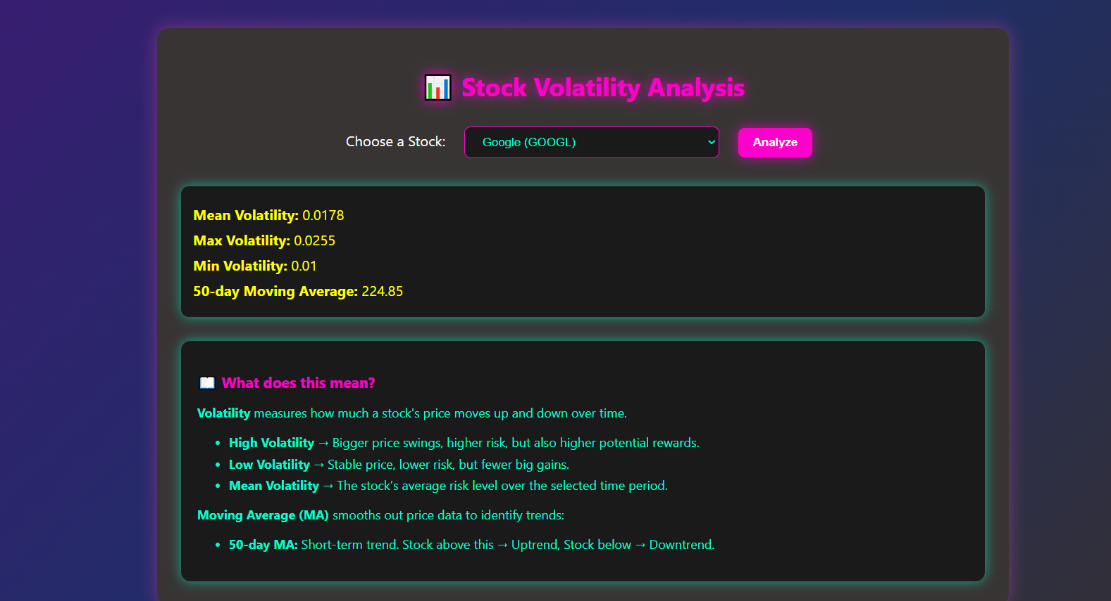
FUNCTION 3: STOCK VOLATILITY ANALYSIS
Focuses on analysing the volatility and moving average of selected stocks.
Example: Tata Consultancy Services (TCS.NS).
Key Outputs:
- Mean Volatility: 0.0115
Maximum Volatility: 0.0164
- Minimum Volatility: 0.0083
- 50-day Moving Average: 224.85
Explains volatility in simple terms:
- High Volatility → Higher risk and reward.
- Low Volatility → More stability, lower risk.
Moving Average (MA) smooths out price data to identify trends:
50-day MA: Short-term trend. Stock above this → Uptrend, Stock below → Downtrend.
Helps investors assess stock risk profile for better investment strategies.
This feature educates users about stock behaviour over time.

Slide 6
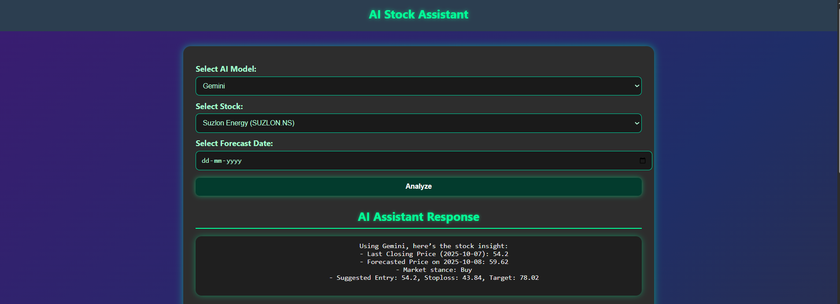
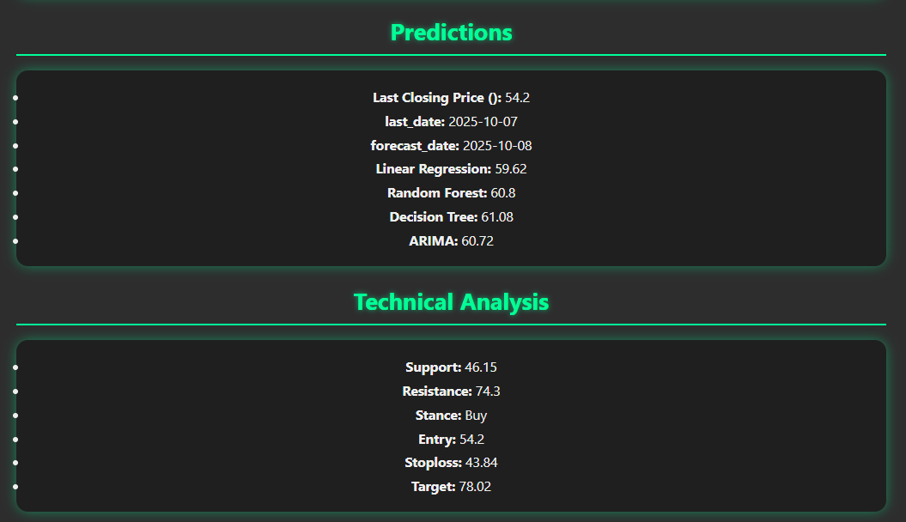
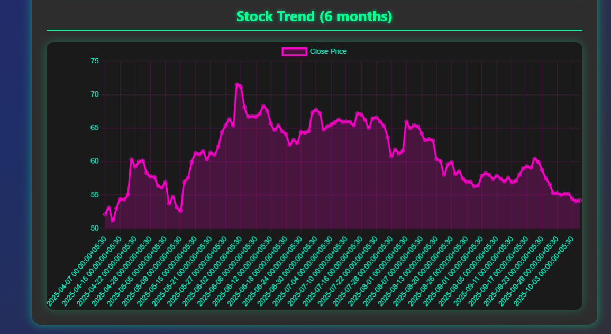
FUNCTION 4: AI STOCK ASSISTANT
AI-powered assistant for intelligent stock insights.
Example: Suzlon Energy (SUZLON.NS).
Provides forecasted price, market stance (Buy/Sell), and trading strategy.
Technical Analysis:
- Support and resistance levels.
- Suggested entry price, stoploss, and target.
Multiple models compared: Linear Regression, Random Forest, Decision Tree, ARIMA.
Trend analysis over 6 months for better context.
This functionality empowers investors with AI-driven decision support.

Slide 7




TECHNOLOGIES USED
Programming Language: Python
Libraries: Pandas, NumPy, Matplotlib, Seaborn, Plotly
ML Models: Linear Regression, Random Forest, Decision Tree, ARIMA model.
AI Model: Gemini, Gpt4, Gamma, Mistral
Visualization Tools: Matplotlib, Plotly
Dataset: yfinance

Slide 8

CONCLUSION
The Stock Price Analysis Project integrates data analytics, forecasting, volatility assessment, and AI-based recommendations.
Key Benefits:
- Holistic view of stock performance.
- Informed investment decisions.
- Risk management through volatility analysis.
- AI-driven personalized recommendations.
Overall, the system provides a comprehensive solution for investors, analysts, and researchers.

Slide 9


